Slide 1
FYP5: Object Detection, Tracking and Suspicious Activity Recognition for Maritime Surveillance using Thermal Vision

Slide 2
Weekly Tasks
Try to implement a basic PID controller given in a paper on Matlab or python and see its outputs.
Get hands on experience in Matlab and Python Control System Modules.
Study more about stabilization loops and tracking loops.
Start learning Adams/SolidWorks for simulations.

Slide 3
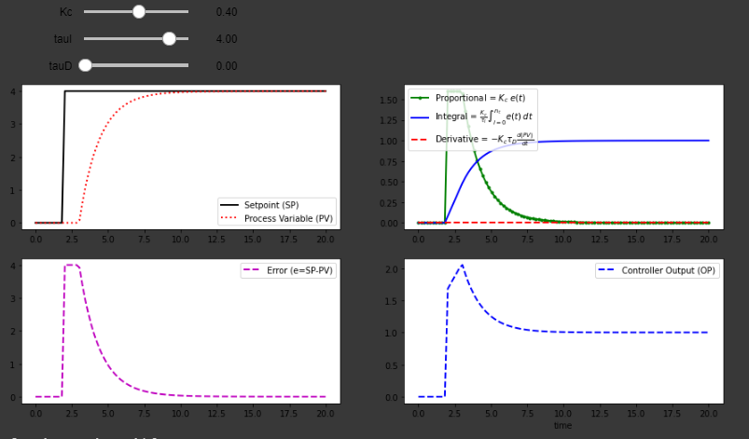
Implementing a simple PID and Kalman Filter
Chose the language as Python to begin with
Implemented a simple PID Controller using Python to test with real time IMU data

Slide 4
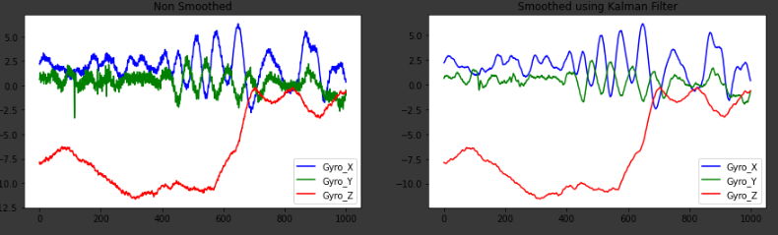
Kalman Filter Design
Gyro and Accelerometer data we found are too noisy and tends to give bad results in the control system
We implemented a Kalman Filter to smoothen the curves and remove the glitches of the Gyro and Accelerometer data and tuned it

Slide 5
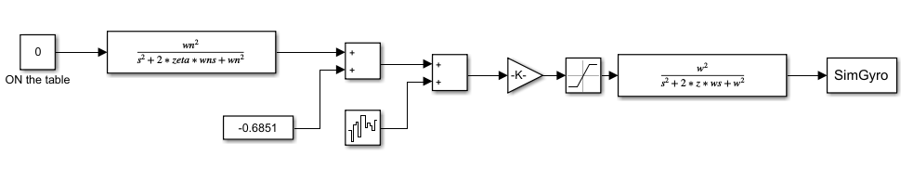
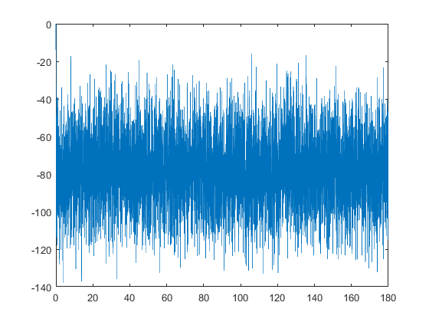
MATLAB Gyro Model

Slide 6
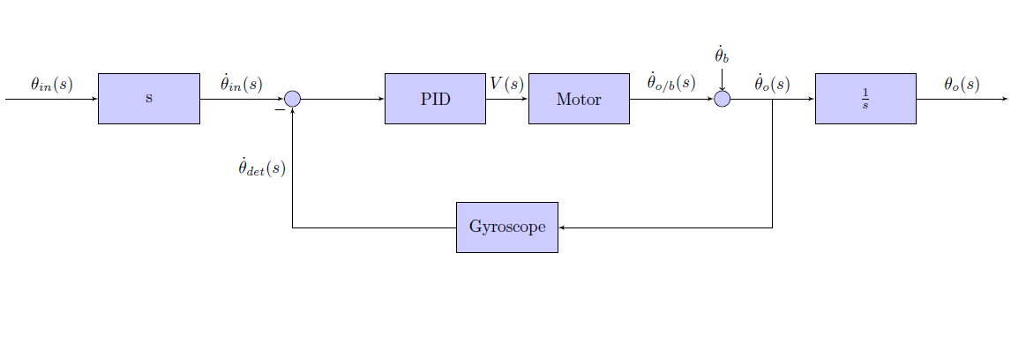
Basic Control Block Diagram

Slide 7
IMU simulation in Python
Control System simulation in Python
Use a package called “gnss-ins-sim” to simulate readings from an IMU based on some motion profile
Based on the given IMU settings, the package will predict the IMU readings and the error caused by the IMU.
Useful model to select an appropriate IMU.
Use a package called python-control.
Contains control.matlab, which is a library of MATLAB-like commands that can be used.
All need to be coded unlike the MatLab Simulink Package

Slide 8
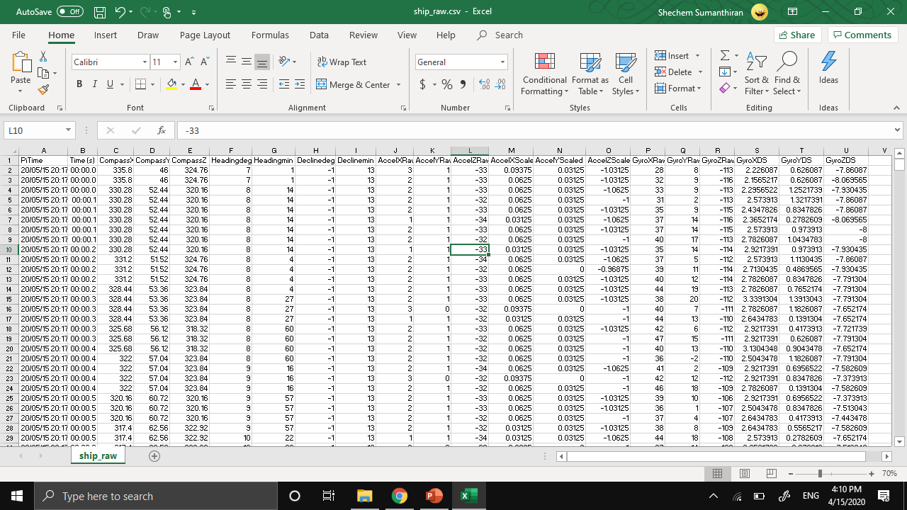
Motion Profile of a Ship
Also obtained IMU sensor readings dataset from a fishing vessel.
Can use this to evaluate performance of our control systems
Dataset accessible at ship_raw.xlsx

Slide 9
Kinematic model of the Stewart Platform
Inverse Kinematics are simpler than Forward Kinematics for a Stewert Platform
Why Inverse Kinematics are more Important for us?
During tracking, we need our platform to be at a desired position and orientation. (POSITION AND ORIENTATION OF THE PLATFORM IS KNOWN)
WHAT WE WANT is to have the required Motor Parameters, Leg Lengths, Servo Angles to drive the platform to the desired position and orientation.
Two Stage of Inverse Kinematic problem
Calculation of each joint on platform from its corresponding base joint for a desired position and orientation of platform
Servo angles that put each platform joint in the previously calculated position
We also need to impose several CONSTRAINTS when designing the hexapod platform to define the range of movement

Slide 10
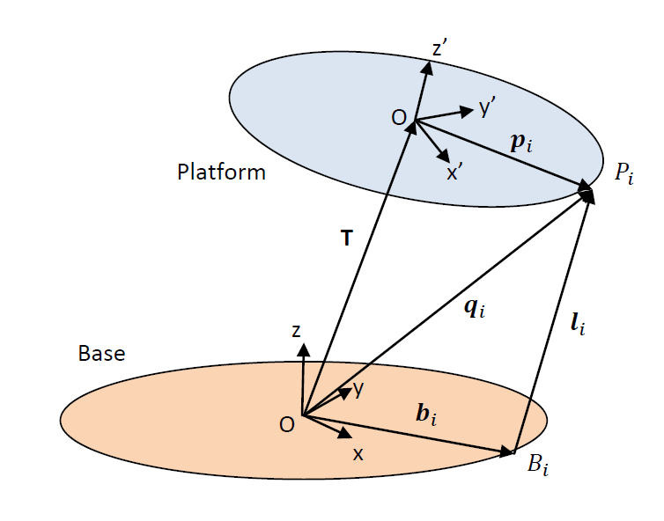


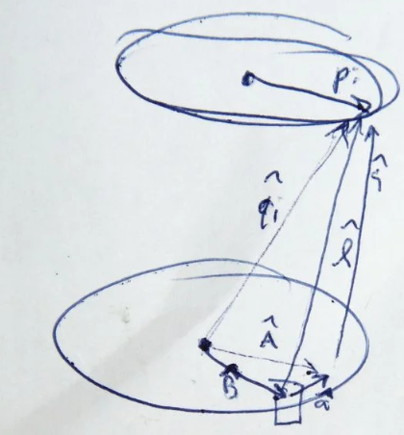
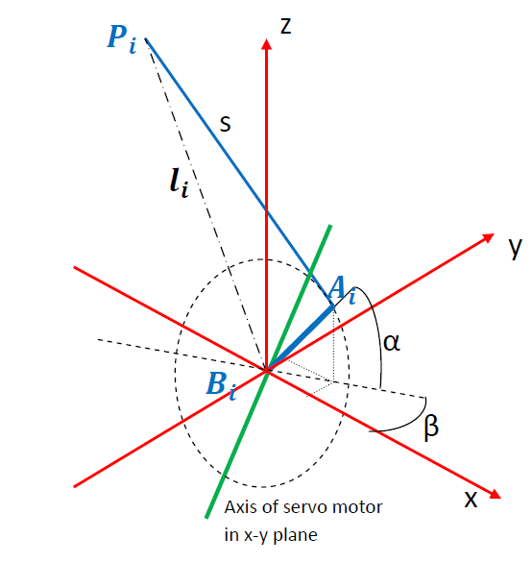
Calculation of each joint on platform from its corresponding base joint for a desired position and orientation of platform ​
o'x'y'z – coordinate frame of the platform
oxyz – coordinate frame of the base
P_{i} - i^{th} joint on platform
B_{i} - i^{th} joint on base corresponding to P_{i}
Goal : to find the l_{i} for all the joint pairs on platform and base
For 6 joint-pairs, we can find the lengths of 6 legs
Servo angles that put each platform joint in the previously calculated position ​
A_{i} - points on arm of the i^{th} servo
B_{i} - Point of rotation of i^{th} servo arm
α - angle of servo arm from horizontal plane
β - angle of servo arm plane w.r.t. x-axis of base
s - length of the operating leg
Goal : to find the s, α, β

Slide 11
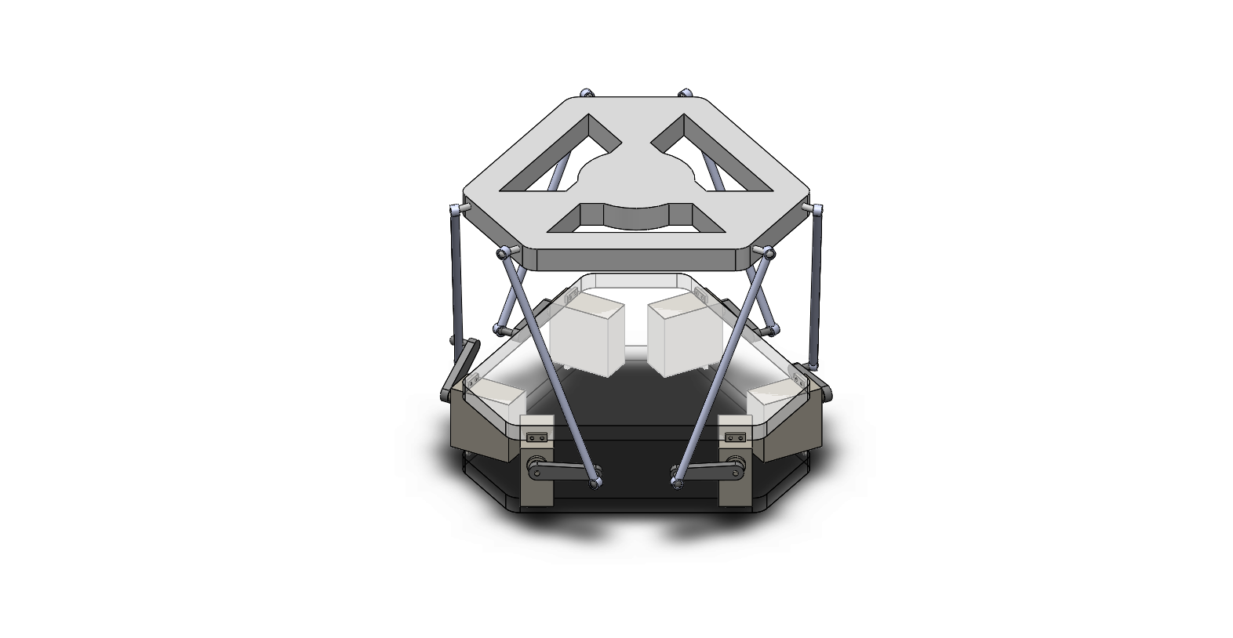
Start learning Adams/SolidWorks for simulations.

Slide 12

Motion Study

Slide 13

Tasks for next week
Begin the control system, platform model and IMU data for a full simulation
Simulation of the Platform by considering the mathematical model of the Stewart platform and Solidworks

